Slide 1
Condition
Medication Request
Vital Signs Observation
Analysis Normal Form

Slide 2
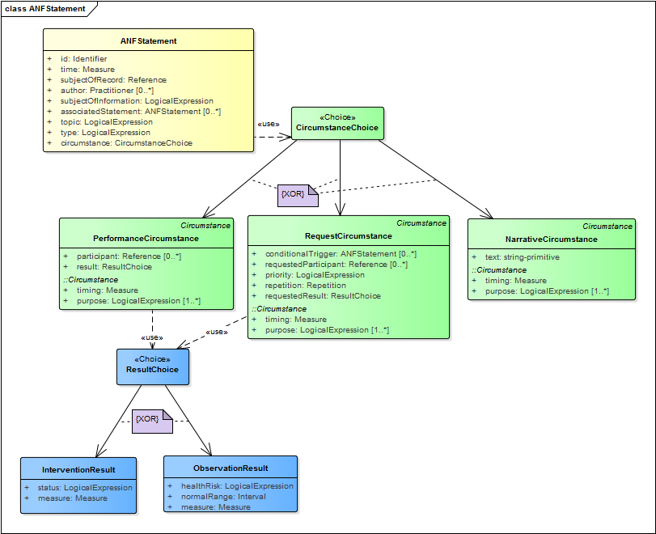
“circumstance” choice
Exclusive OR
Base class
“result” choice
Inherited attributes
Exclusive OR
Encapsulated “measure”

Slide 3
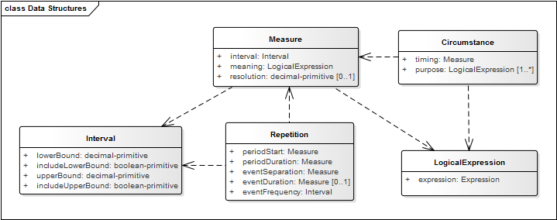
Building blocks

Slide 4
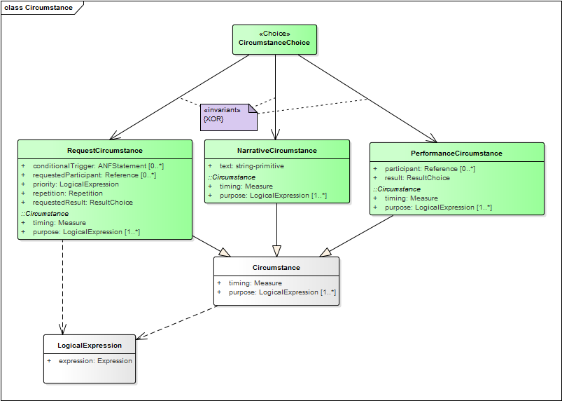
Polymorphic structures: Circumstance

Slide 5
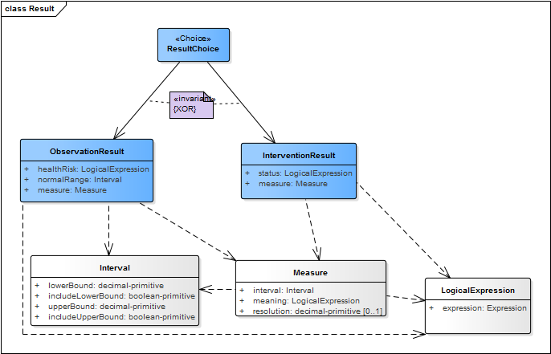
Polymorphic structures: Result

Slide 6
Order vital signs exam:
Statement → Request → Observation Result

Slide 7
Record vital signs exam completed:
Statement → Performance → Intervention Result

Slide 8
Vital signs result (e.g. systolic blood pressure):
Statement → Performance → Observation Result

Slide 9
Order discharge medication:
Statement → Request → Intervention Result

Slide 10
Medication administered:
Statement → Performance → Intervention Result

Slide 11
Administered dialysis:
Statement → Performance → Intervention Result

